Slide 1

WELCOME

Slide 2
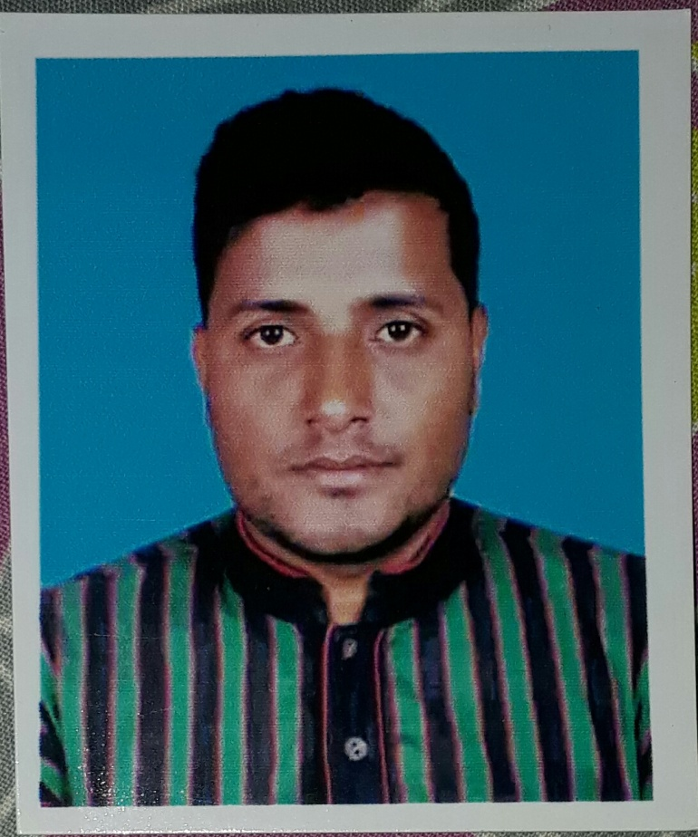
Introduction
Md Jakaria mahmud
Asst.Teacher
Chhotadamai high School Juri moulvibazar.
jakariamahmud84@gmail.com

Slide 3
ENGLISH 2nd PAPER
Class- Seven
Subject-English 2nd paper
Unit- 02
Time- 40 Minis

Slide 4

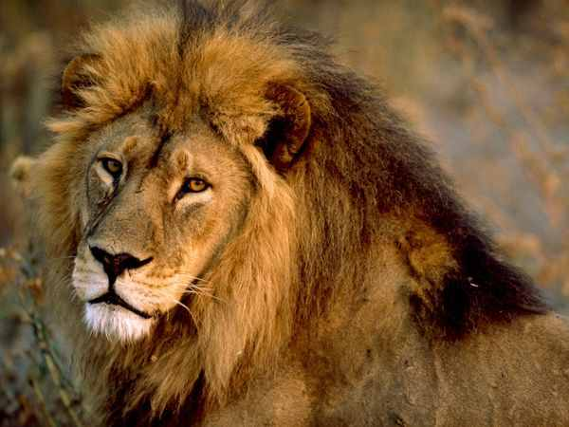
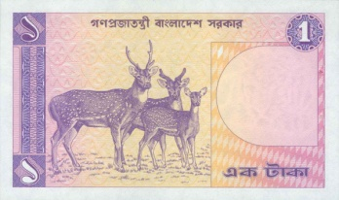
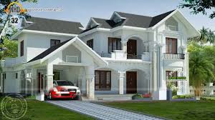

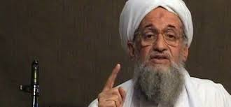
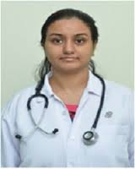
Look at the picture
A
lion
A
One-taka note
A
house
An
egg
An
honest
An
M.B.B.S

Slide 5

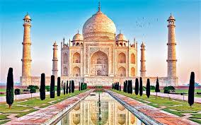
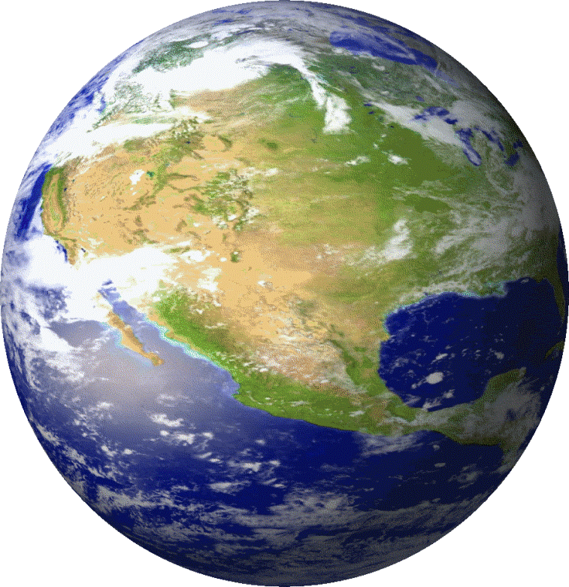
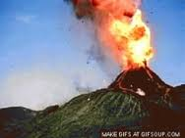
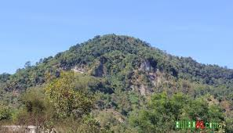
The
Quran
The
Tajmahol
The
Earth
The
Volcano
The
Hill

Slide 6


Lesson Title
Article

Slide 7

Learning outcome
Students will be able to-
What is article.
Kinds of articles.
Use of articles.

Slide 9
Articles: The three ‘a’, ‘an’ and the called articles, These are also Demonstrative Adjective.
Articles are of two types: 1. Indefinite Article
2. Definite Article.
Indefinite Article: ‘A’ or ‘An’ called Indefinite Article. They do not point out any person or object particularly. Such articles point out the nouns in general.
Definite Article: ‘The’ is termed as Definite Article. It points out any particular person or object, but not in general.

Slide 10
Use of indefinite article: A, An
Use of A
Use of An
word এর প্রথম consonant letter হলে তাহার পূর্বে a বসে।
I saw a bird.
word এর প্রথম letter vowel থাকা সত্বেও যদি ‘ইউ’ বা ‘অয়া’ -এর মত উচ্চারণ হয়, তবে তাহার পূর্বে a বসে।
She is a University.
word এর প্রথম letter ‘H’ (হ) উচ্চারিত হয়, তবে তাহার পূর্বে a বসে।
He is a historian.
word এর প্রথম vowel letter হলে তাহার পূর্বে an বসে।
I do not like an idle man.
word এর প্রথম letter consonant থাকা সত্বেও যদি vowel -এর মত উচ্চারণ হয়, তবে তাহার পূর্বে an বসে।
He is an M.A.
word এর প্রথম letter ‘H’ (হ) উচ্চারিত না হলে, তবে তাহার পূর্বে an বসে।
I can do it in an hour.

Slide 11
Use of definite article: The
নির্দিষ্ট ব্যক্তি বা বস্তু, জাতি, সম্প্রদায়, গোষ্ঠী, দল, ভৌগোলিক নাম বা স্থান, প্রসিদ্ধ প্রতিষ্ঠান, ঐতিহাসিক ঘটনা, সংবাদপত্রের নাম, তারিখ, ঋতু, দিক, প্রকৃতির নিদর্শণ ( নদী, পাহাড়), সৌরজগতের (গ্রহ, উপগ্রহ, নক্ষত্র ) জাহাজ, ধর্মগ্রন্থ ইত্যাদির পূর্বে The বসে।
1. The girl is laughing.
2. The roses a lovely flower.
3. The Quran is a holy book.
4. The sun rises in the east. etc

Slide 12



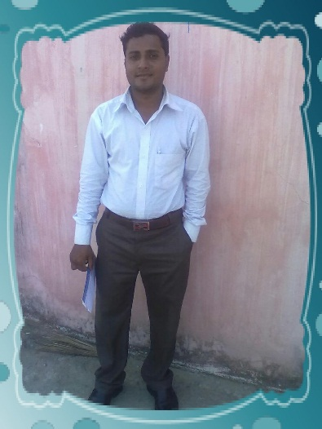

# What is article?
Article
# How many kinds of article?
# What is use?
Use of
Use of
1. Indefinite Article
2. Definite Article
moon
An
The
A
apple

Slide 13
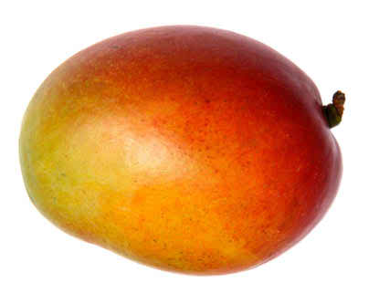
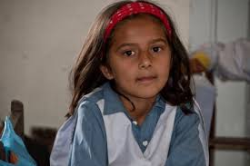
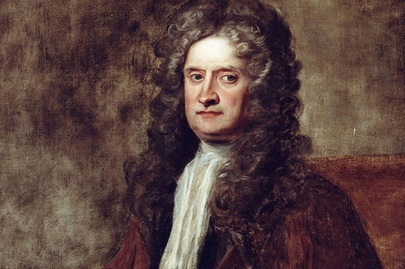
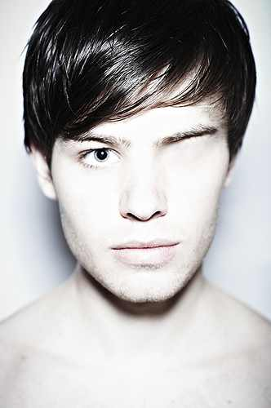
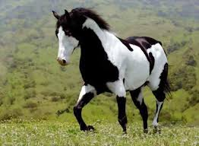
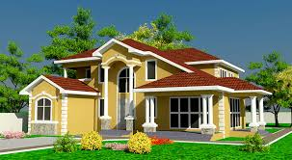
Use of ‘a’
__ mango
A
__ student
A
‘A’ is used before a word beginning with:
a consonant
__ European
A
A
vowel having the sound of ‘yu’ or ‘wa’
__ one-eyed man
sound ‘h’
__ horse
A
A
__ house
Here ‘a’ is indefinite article.

Slide 14
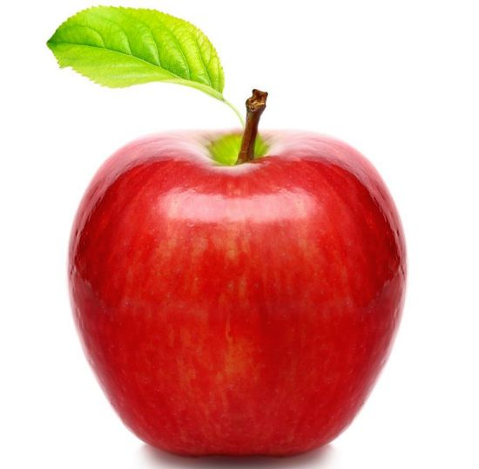
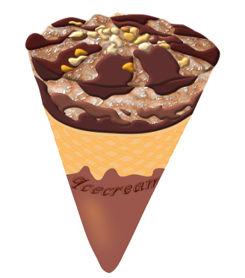
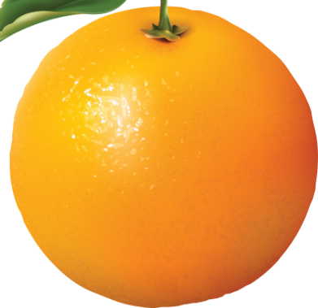


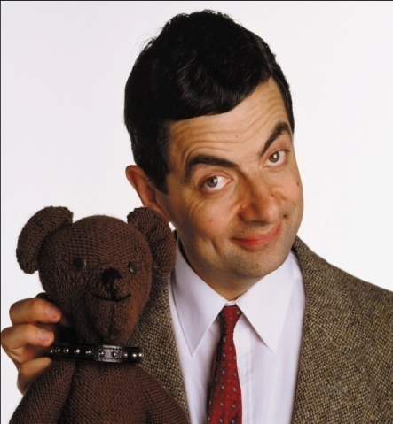
Use of ‘an’
An
___ apple
___ egg
An
An
___ ice-cream
‘An’ is used before a word beginning with:
a vowel (a, e, I, o, u)
consonant having the sound of ‘vowel
An
___ orange
___ umbrella
An
Silent ‘h’
An
An
Here ‘an’ is indefinite article.
___ M. A.
___ honourable person

Slide 15
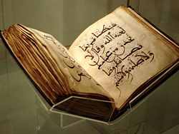
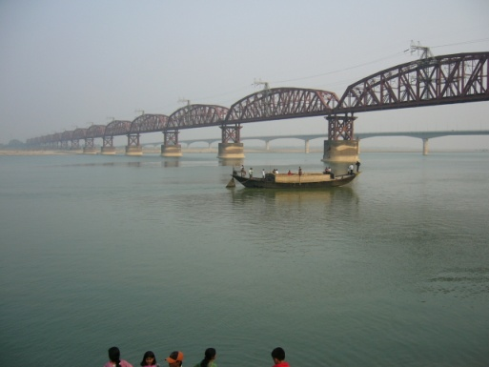
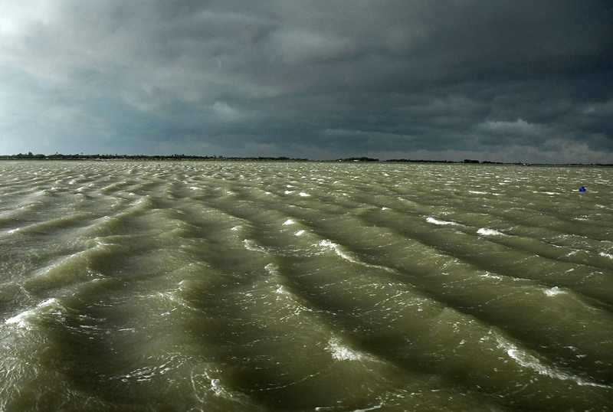
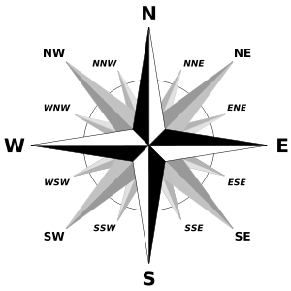
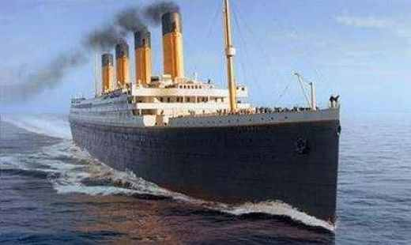
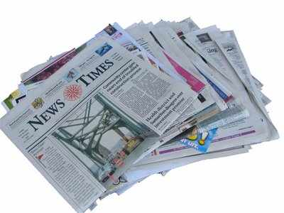
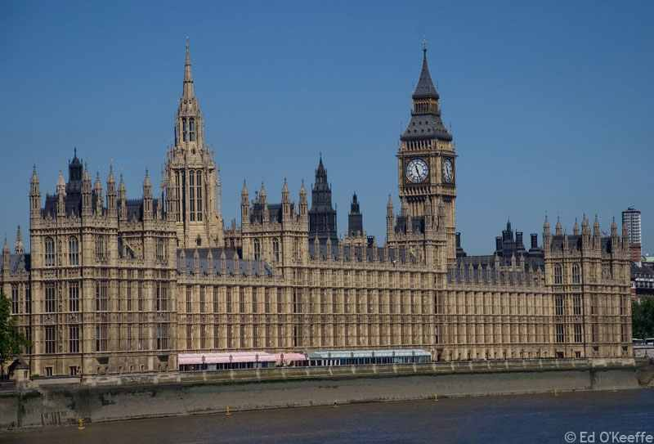
The
The
___ Quran
The
The
___ North
___ Padma
___ Bay of Bengal
The
The
___ Titanic
___ Bangladesh Times
The
___ Westminster palace
Here ‘The’ is definite article.

Slide 16

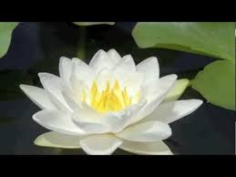
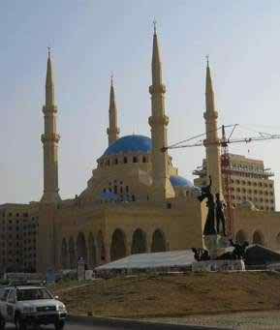
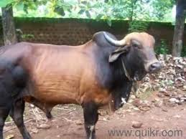
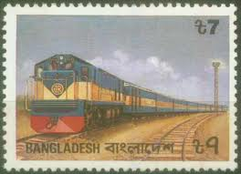
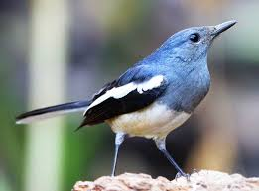
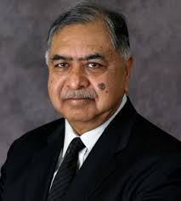
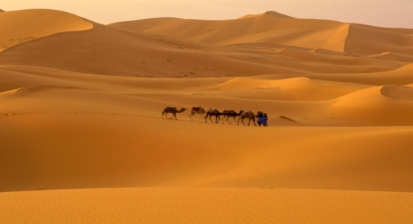
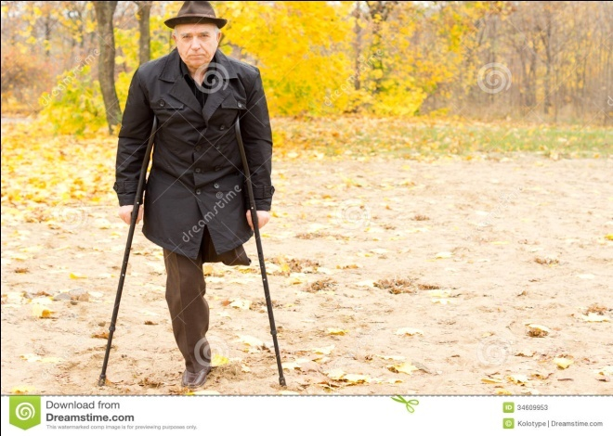
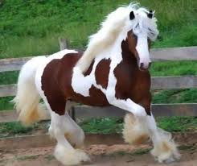
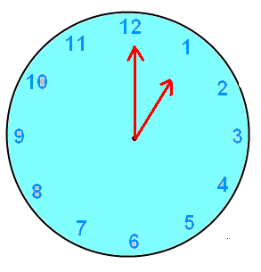
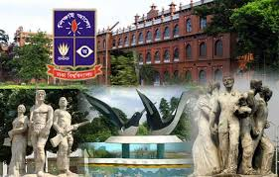
Single Work
Fill in the gaps with appropriate articles:
An
The
__ ox
The
A
___ Mosque
___ Jamuna Express
__ flower
___ Shahara
An
The
__ one-legged man
A
__ L. L. B
__ bird
A
A
The
__ horse
An
A
___ Bangladesh times
__ hour
__ university

Slide 17
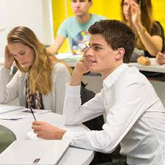
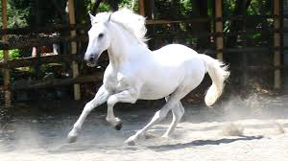
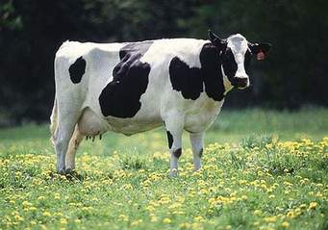
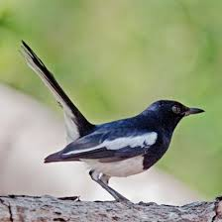
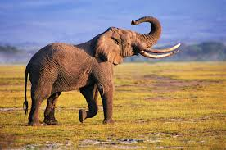
Pairs Work
___ Quran is __ holy book.
The
a
__ horse.
___ horse is __ beautiful animal.
A
The
a
A
__ cow.
___ cow gives us milk.
The
a
I saw __ bird.
___ bird is black.
The
___ Elephant.
___ Elephant is __ large animal.
An
The
a

Slide 18
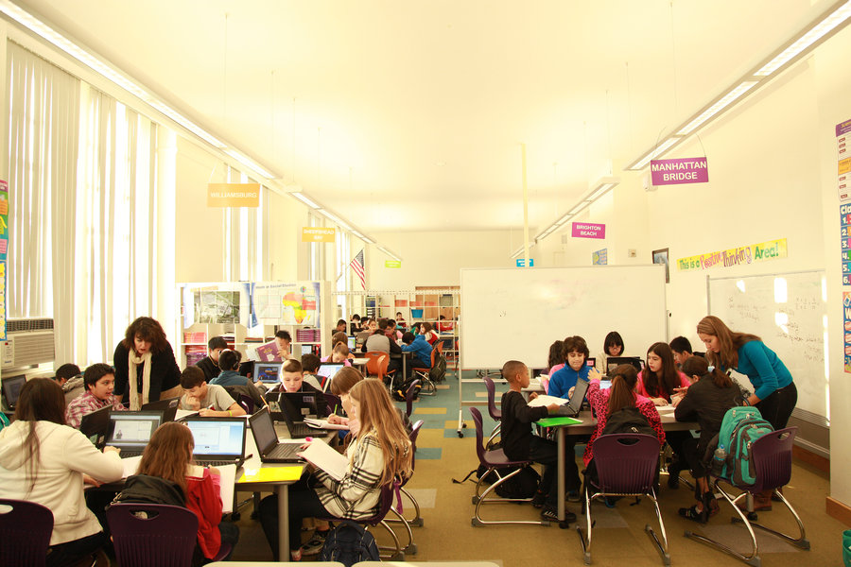

Group Work
Group- A: Write the use of indefinite article:
Group- B: Write the use of definite article:

Slide 19
Evaluation
FIll in the blanks with appropriate article:
She is __ beauty
Give me __one-taka note.
Ferdousi is __ homer of Asia.
He is ___ unwise man.
Prity is ___ M.B.B.S.
She is ___ honours graduate.
____ Bay of Bengal is dangerous.
a
a
a
an
an
an
The

Slide 20

Home Work
Fill in the gaps of the following text with appropriate articles. Put a cross for zero article:
English is (a) __ international language. It is spoken all over (b) ___ world. So the importance of (c) __ English cannot be described in words. All (d) ___ books of higher education are written in English. Today organization need employees who can speak and write (e) _____ standard form of (f) __ English.

Slide 21



Read
Attentively
Thank you

